Slide 1

DATA BASE MANAGEMENT SYSTEM(DBMS)
HOSPITAL MANAGEMENT SYSTEM
Presented by
B.BHANU PRAKASH (25B11AI102)
M.GANESH REDDY (25B11AI772)
T.SANTOSH REDDY (25B11AIC08)
G.SIVA RAMA SWAMY (25B11AI382)
GUIDED BY
Mrs. G.L. NARASAMBA VANGURI MADAM
Department of
Artificial Intelligence and Machine Learning

Slide 2

DATABASE MANAGEMENT SYSTEM | MINI PROJECT
Hospital Management
System
[ You
r ]
[ Roll No. ]
[ Department ]
A centralized relational database solution for patient care, appointments, billing and pharmacy operations
[ C
[ Guide Name ]
[ 20XX - 20XX ]
Notes:
<number>

Slide 3
Abstract
01
The Hospital Management System (HMS) is a database-driven application that automates core hospital operations — patient registration, doctor and staff management, appointments, billing, pharmacy and prescriptions — through one centralized relational database.
Doctors
Patients
Pharmacy
✓
Reduced paperwork
CENTRAL
HOSPITAL DATABASE
✓
Improved operational efficiency
✓
Secure, role-based data storage
✓
Single centralized database
Laboratory
Departments
✓
Better and faster patient care
Billing
Hospital Management System | DBMS Mini Project
2
Notes:
<number>

Slide 4
Problem Statement
02
REAL-WORLD PROBLEMS IN THE EXISTING
SYSTEM
Traditional System
Automation system
Paper registers
Relational database
!
Manual paperwork
!
Data redundancy
Registers and files consume time and space
Same patient recorded many times
Duplicate entries
Normalized data
!
Appointment conflicts
!
Billing errors
Manual billing
Automated billing
Double booking of doctor slots
Manual calculation mistakes
Slow retrieval
Instant search
!
Slow history retrieval
!
No centralized records
Past records are hard to trace
Departments work in isolation
Data loss risk
Backup & security
“A patient visits the hospital multiple times, but their previous records are
stored in different registers. Staff may create another record instead of
finding the existing one, making medical history difficult to retrieve.”
!
Hospital Management System | DBMS Mini Project
3
Notes:
<number>

Slide 5
Objectives
03
01
Automate hospital operations
09
Improve inter-department communication
02
Maintain centralized database
PROJECT
OBJECTIVES
08
Generate reports
03
Improve patient care
07
Reduce paperwork
04
Efficient appointment scheduling
06
Secure medical records
05
Digital billing
Hospital Management System | DBMS Mini Project
4
Notes:
<number>

Slide 6
Number of Entities — 08
04
✚
Doctor
▦
Department
⚕
Patient
◷
Appointment
HOSPITAL
MANAGEMENT
SYSTEM
₹
Billing
⚘
Medicine
☻
Staff
✎
Prescription
Hospital Management System | DBMS Mini Project
5
Notes:
<number>

Slide 7
Attributes of Each Entity
05
PATIENT
DOCTOR
DEPARTMENT
APPOINTMENT
◆ Patient_ID
• Name
• Age
• Gender
• Phone
• Address
• Blood Group
◆ Doctor_ID
• Name
• Specialization
• Experience
• Phone
• Department_ID
◆ Department_ID
• Department_Name
• Floor
◆ Appointment_ID
• Patient_ID
• Doctor_ID
• Date
• Time
• Status
BILLING
STAFF
PRESCRIPTION
MEDICINE
◆ Bill_ID
• Patient_ID
• Amount
• Payment_Mode
• Date
◆ Staff_ID
• Name
• Position
• Salary
◆ Prescription_ID
• Appointment_ID
• Medicine_ID
• Dosage
◆ Medicine_ID
• Medicine_Name
• Price
• Stock
◆ Primary key attribute
Hospital Management System | DBMS Mini Project
6
Notes:
<number>

Slide 8
Primary Keys & Foreign Keys
06
ENTITY | PRIMARY KEY | FOREIGN KEY (REFERENCES)
Patient | Patient_ID | —
Doctor | Doctor_ID | Department_ID → Department
Department | Department_ID | —
Appointment | Appointment_ID | Patient_ID → Patient, Doctor_ID → Doctor
Billing | Bill_ID | Patient_ID → Patient
Staff | Staff_ID | —
Medicine | Medicine_ID | —
Prescription | Prescription_ID | Appointment_ID → Appointment, Medicine_ID → Medicine
Primary Key
Foreign Key
Referential integrity: every foreign key value must exist in the referenced primary key column.
Hospital Management System | DBMS Mini Project
7
Notes:
<number>

Slide 9
Relational Schema
07
PATIENT
DOCTOR
DEPARTMENT
APPOINTMENT
Patient_ID
Doctor_ID
Department_ID
Appointment_ID
Name
Name
Department_Name
Patient_ID
Age
Specialization
Doctor_ID
Gender
Department_ID
Date
Phone
Time
Address
BILLING
STAFF
MEDICINE
PRESCRIPTION
Bill_ID
Staff_ID
Medicine_ID
Prescription_ID
Patient_ID
Name
Name
Appointment_ID
Amount
Position
Price
Medicine_ID
Date
Stock
Dosage
Arrows point from a foreign key to the referenced relation. Appointment.Patient_ID → PATIENT and Appointment.Doctor_ID → DOCTOR.
Hospital Management System | DBMS Mini Project
8
Notes:
<number>

Slide 10
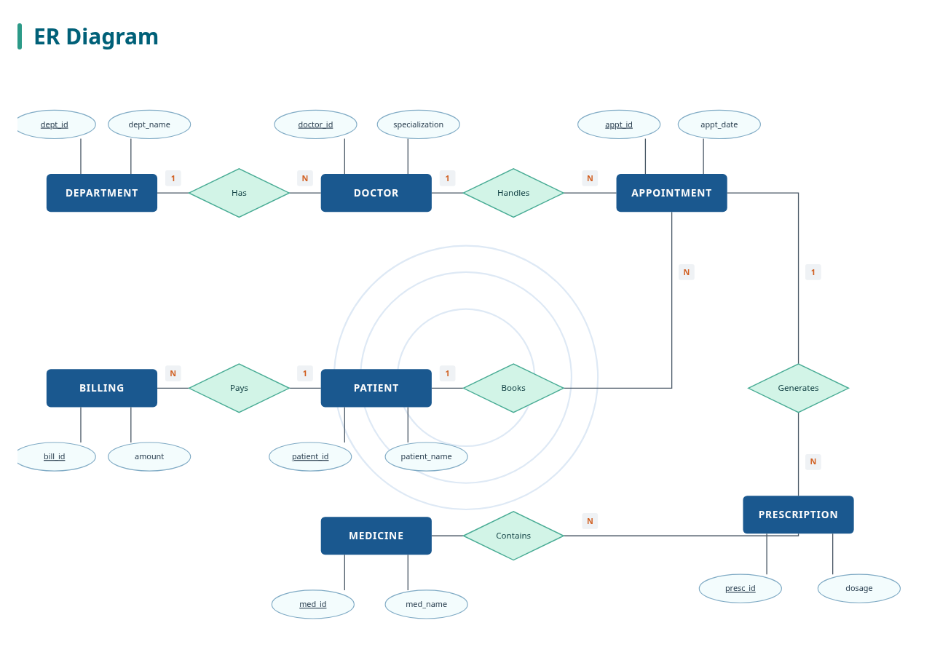

Slide 11
Advantages
⚡
▦
✎
★
₹
Faster patient registration
Better appointment scheduling
Reduced paperwork
Improved security
Accurate billing
≡
▥
☎
❤
⚕
Better data consistency
Faster report generation
Improved communication
Better patient care
Efficient hospital management
Hospital Management System | DBMS Mini Project
11
Notes:
<number>

Slide 12
Key Constraints
09
◆
Entity Integrity
↔
Referential Integrity
✓
Domain Constraints
Every primary key (Patient_ID, Doctor_ID...) must be unique and never NULL.
Appointment.Doctor_ID must match an existing Doctor row.
Age is numeric, Gender ∈ {M, F, O}, Amount ≥ 0, Date is a valid date.
✖
NOT NULL Constraints
★
UNIQUE Constraints
Name, Phone, Appointment Date and Bill Amount cannot be empty.
Phone number and Medicine_Name are unique across the table.
Hospital Management System | DBMS Mini Project
10
Notes:
<number>

Slide 13
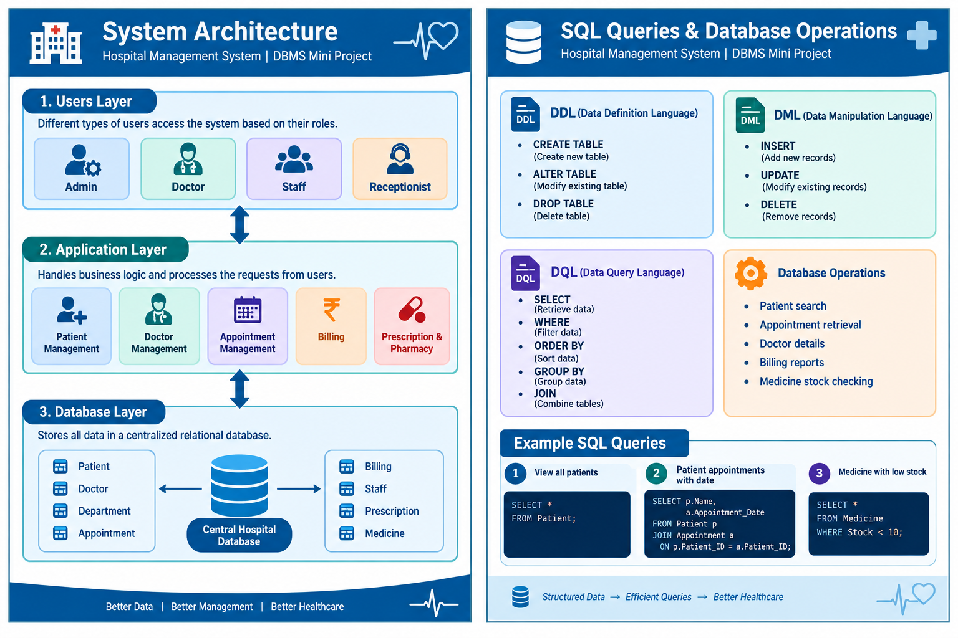

Slide 14
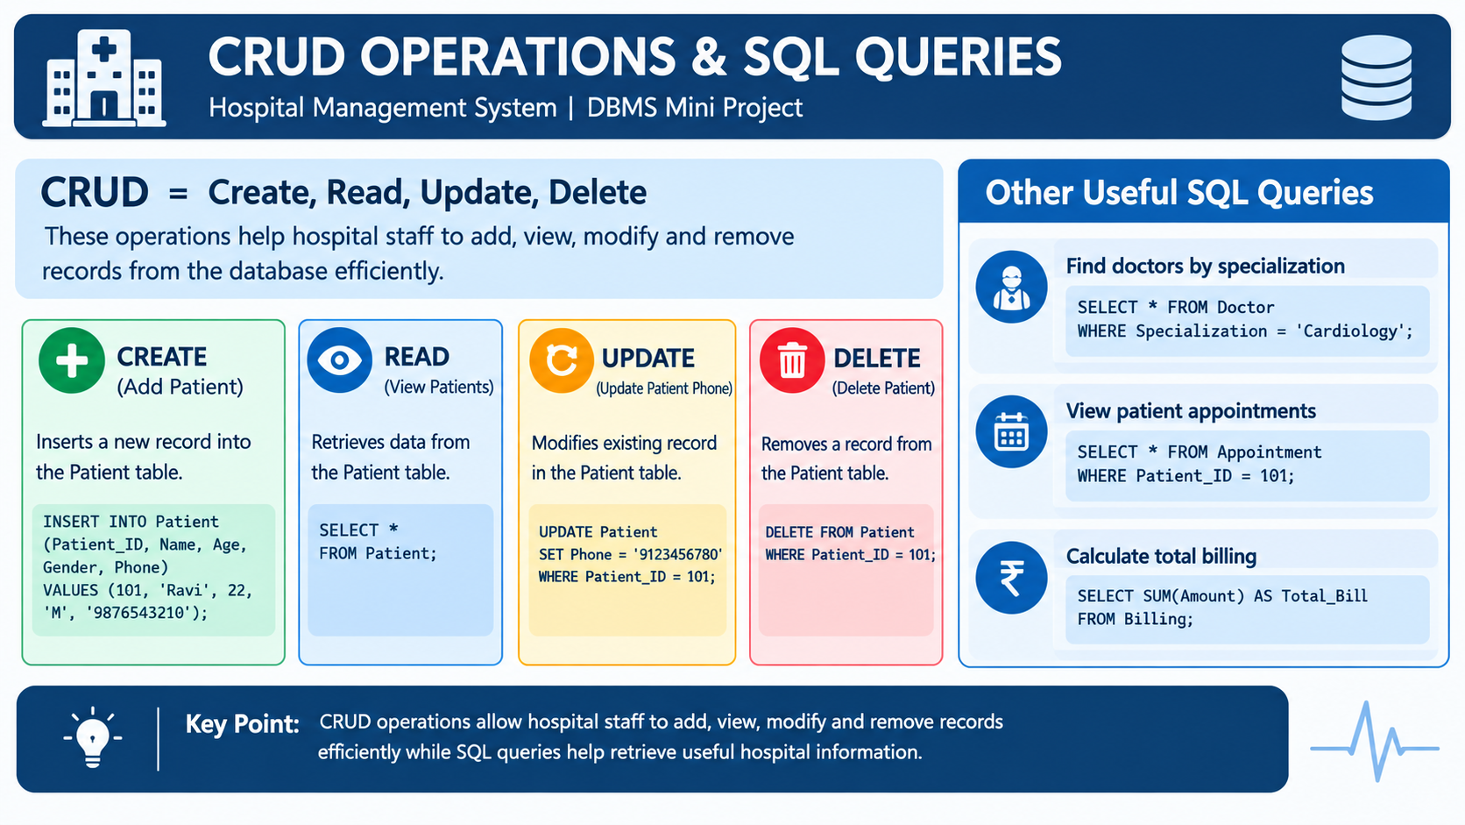

Slide 15
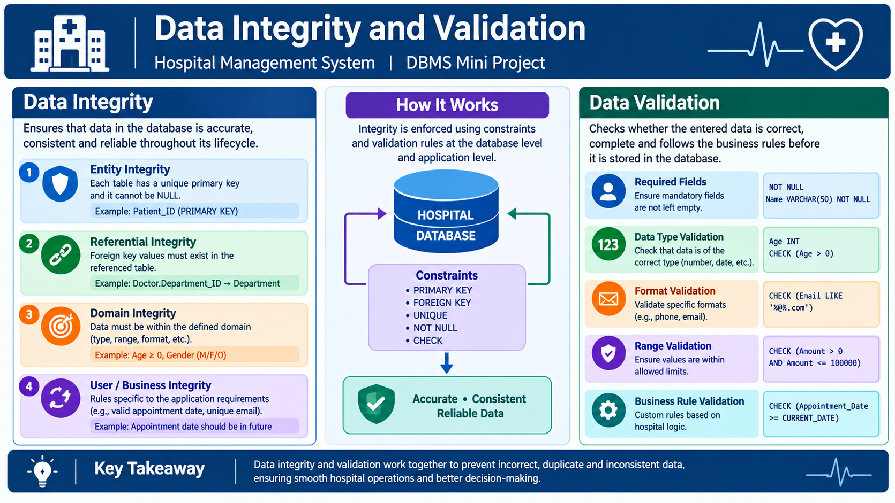

Slide 16
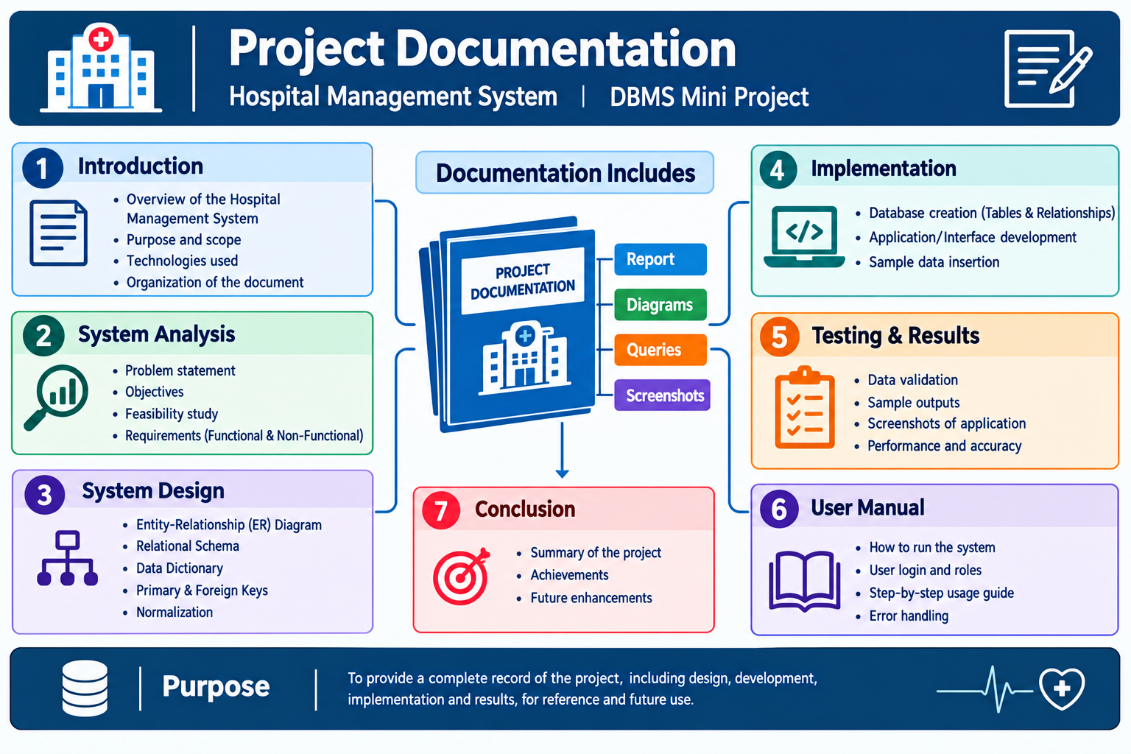

Slide 17
CONCLUSION
A centralized database for smarter hospitals
The Hospital Management System automates hospital operations through a centralized relational database. It removes redundancy, enforces integrity constraints, secures medical records, reduces paperwork and ultimately enhances the quality of patient care.
Automation
Data integrity
Security
Efficiency
Better patient care
Thank You
Questions are welcome
Notes:
<number>

Slide 18
Thank you

